Slide 1
1 Planed
Planed 1
Finish the study of angr and WinDbg(week12-week13) next week.
Do the assignment6 next week.
4

Slide 2
1 Results
Results 1
just finish the week12-week13
4

Slide 3
1 Challenges and Solutions
import angr
import archinfo
import monkeyhex
proj = angr.Project(“.\\binaryobject.exe",load_options={'auto_load_libs': False})
'''
arch information
'''
print(proj.arch)
print(proj.entry)
print(proj.filename)
print(proj.arch.name)
print(proj.arch.bits)
'''
loader
'''
print("-----------------loader---------------------")
print(proj.loader)
print(proj.loader.all_objects)
print(proj.loader.all_pe_objects)
print(proj.loader.shared_objects)
print(proj.loader.main_object)
print(proj.loader.min_addr," ",proj.loader.max_addr)
print(proj.loader.main_object.pic) # I this the output is true
print(proj.loader.main_object.execstack) #it is false why?
Challenges and solutions 1
The output of statement ‘print(proj.loader.main_object.execstack)’ is False. But I think angr can be used to do dynamic analysis, so this binary should have an executable stack.
4

Slide 4
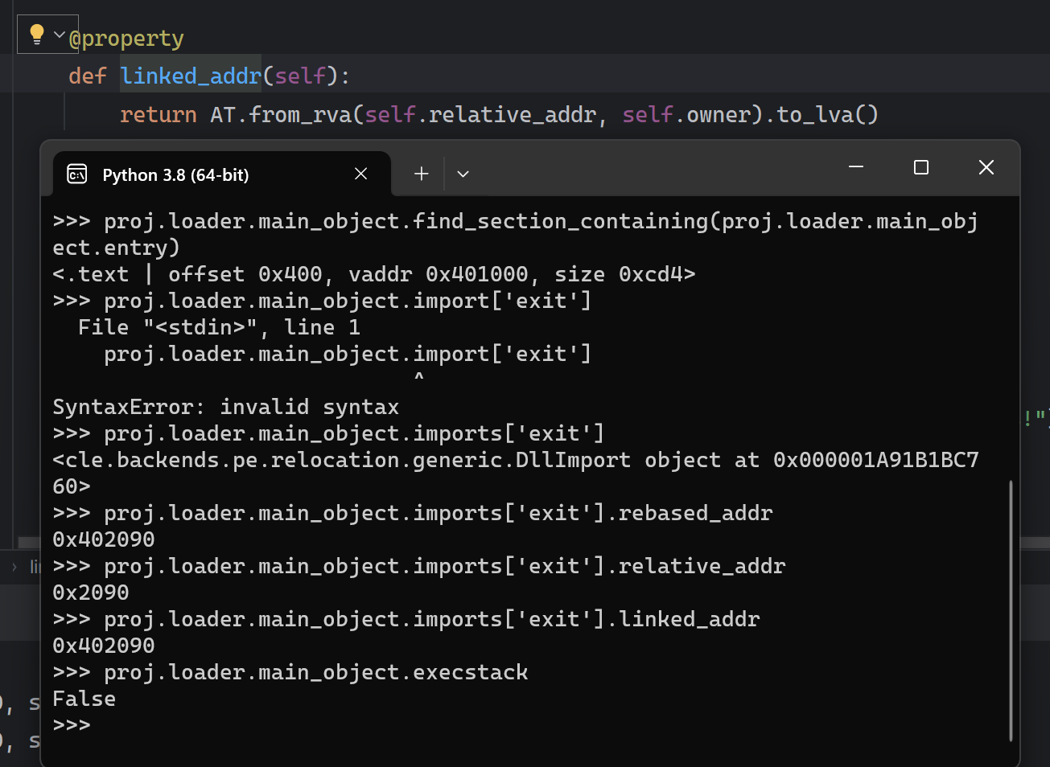
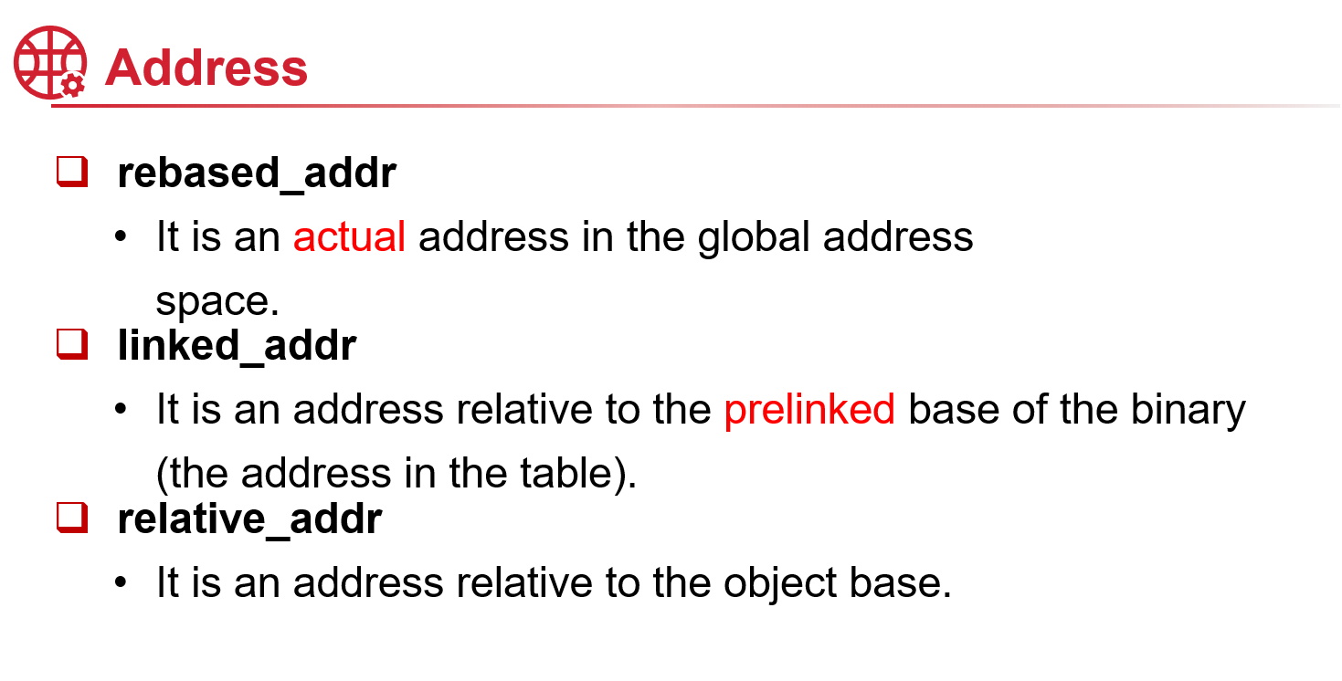




1 Challenges and Solutions
Challenges and solutions 1
Please look at the picture, it shows the implement of linked_addr which translate RVA to LVA.
According to your slide, the ‘rebased_addr’ is an acual address while the ‘linked_addr’ is a relative address, so it is impossible for them to be the same(in this example).
In next slide, the output of ‘linked_addr’ and ‘relative_addr’ are the same!
4

Slide 5
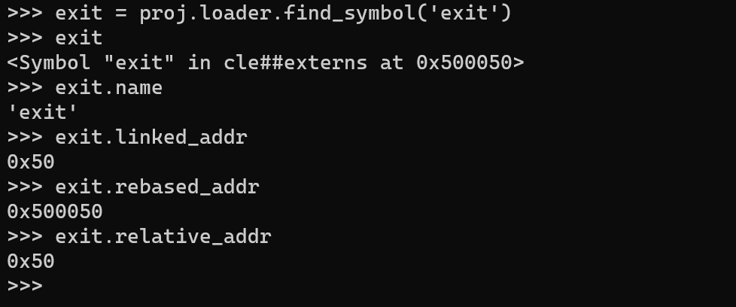
1 Challenges and Solutions
proj = angr.Project("D:\\pythonProject\\binaryobject.exe",load_options={'auto_load_libs': False})
print(proj.loader.main_object.imports['exit'])
print("rebased_addr", proj.loader.main_object.imports['exit'].rebased_addr)
print("linked_addr", proj.loader.main_object.imports['exit'].linked_addr)
exit = proj.loader.find_symbol('exit')
print(exit)
print(exit.name)
print(exit.rebased_addr)
print(exit.linked_addr)
print(exit.relative_addr)
Challenges and solutions 1
In this code, the output of ‘linked_addr’ and ‘relative_addr’ are the same!
4

Slide 6
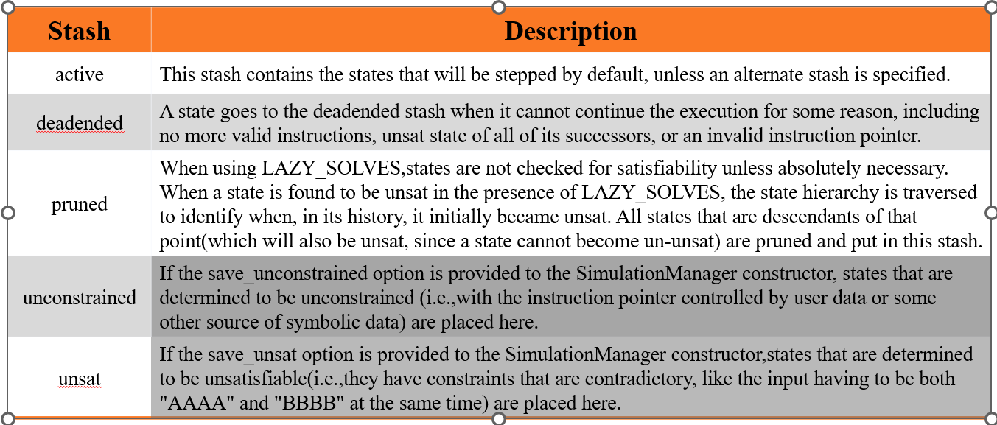
1 Challenges and Solutions
Challenges and solutions 1
还是有点理解不了。这几个stash，2024/1/26
4

Slide 7
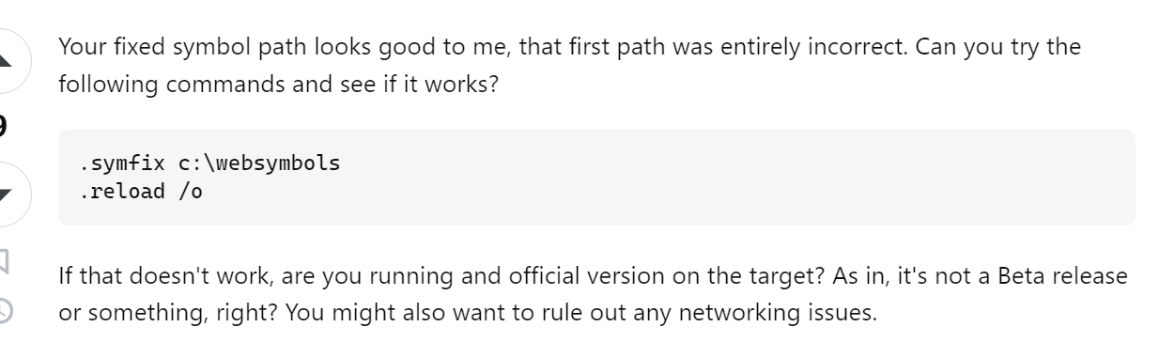
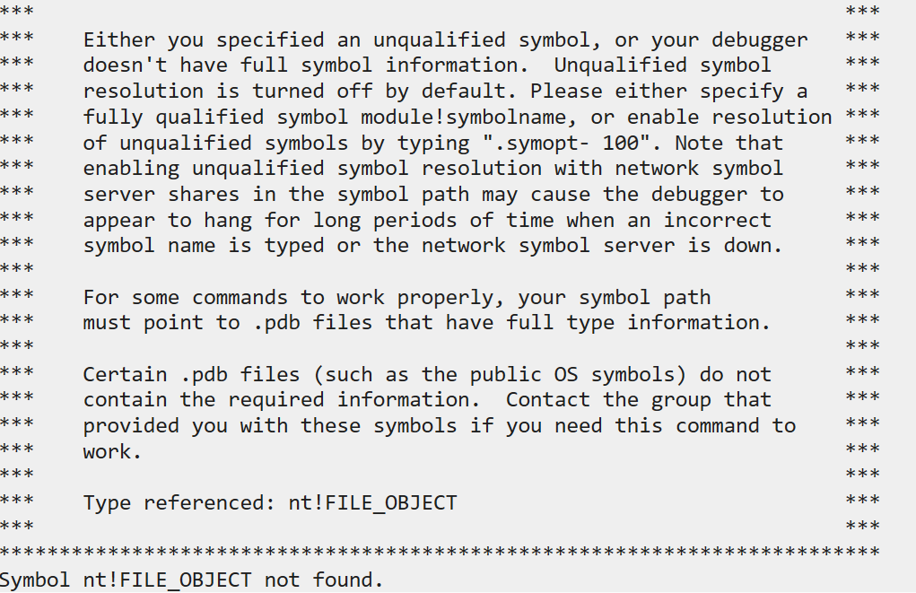

1 Challenges and Solutions
Challenges and solutions 1
solutions
Have solved! I download some packages of symbols.
4

Slide 8
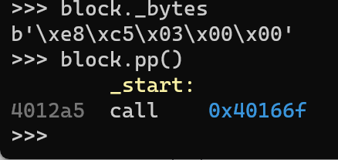



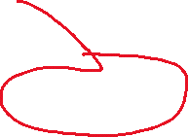


1 Challenges and Solutions
“””
factory
“””
block = proj.factory.block(proj.entry)
print(block.pp())
print(block.instructions)
print(block.instruction_addrs)
print(block.size)
block.capstone.pp()
block.vex.pp()
Challenges and solutions 1
What does the symbol b represent? And what is the string ‘\xe8\xc5\x03\x00\x00’ represent?
4

Slide 9
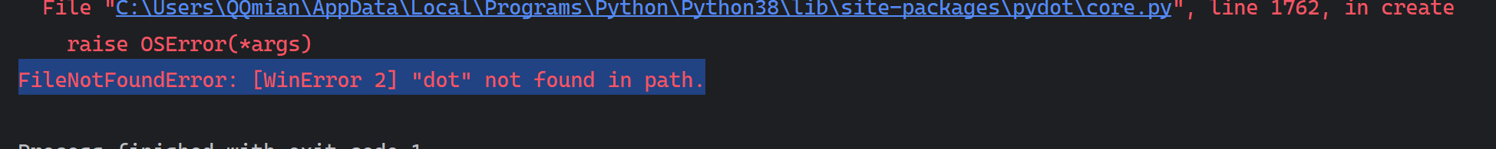
1 Challenges and Solutions
Challenges and solutions 1
def analyze(b,addr,name=None):
start_state=b.factory.blank_state(addr=addr)
start_state.stack_push(0x0)
plot_cg(b.kb,"%s_callgraph"%name,format="png")
plot_cg(b.kb, "%s_callgraph_verbose" % name, format="png", verbose=True)
proj = angr.Project("backdoor1")
analyze(proj,proj.entry,"backdoor")
Haved solved!
4

Slide 10
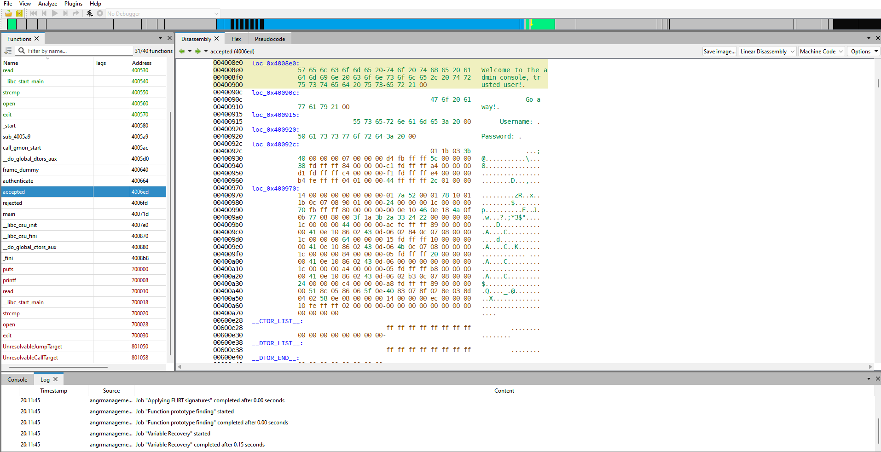
1 Challenges and Solutions
Challenges and solutions 1
How to use angr-management?
4

Slide 11
1 Plan
plan 1
Finish the assignment6
Finish the study of week15-16
Finish the assignment7
4

